Slide 1

State of Wisconsin
School Report Cards
Fall 2014 Results

Slide 2
Department of Public Instruction
“Agenda 2017”
ESEA Waiver
Avoid AYP penalties
Standards
Common Core State Standards
Assessment and Data Systems
Smarter Balanced Assessments
School & Educator Effectiveness
School Report Cards
Response to Intervention
Educator Effectiveness System
WI Waiver Request
ACT Assessment
TONIGHT’s FOCUS

Slide 3
School Report Card
The data presented in this report card are for public, state and federal accountability purposes.
Student performance on the Wisconsin Student Assessment System (WSAS) is the foundation of this report.
WSAS data includes both Wisconsin Knowledge and Concepts Examinations (WKCE) and Wisconsin Alternate Assessment for Students with Disabilities (WAA-SwD).
Results are from the previous year’s test administration (Fall 2013).
Each school receives a report card in addition to an overall district report card.
This is the last year of the current school report card format as all assessments are changing to reflect the new assessments and measurement of the Common Core.

Slide 4
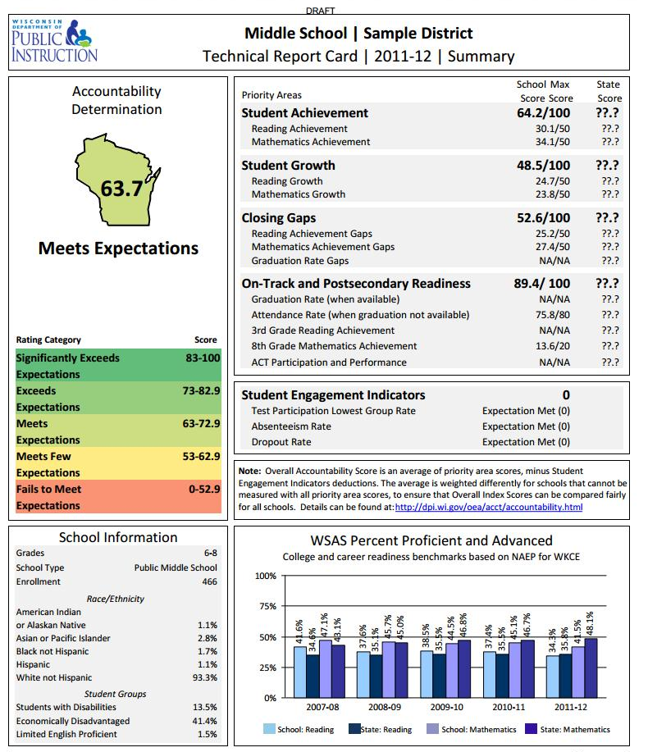
Components:
1. Accountability Determination
2. Priority Areas
3. Student Engagement Indicators
4. School Information
5. WSAS Percent Proficient and Advanced

Slide 5
Components:
1. Accountability Determination
2. Priority Areas
3. Student Engagement Indicators
4. School Information
5. WSAS Percent Proficient and Advanced
Notes:
First is the accountability determination – giving an overall school score on a scale of 1-100, broken down into five categories. This accountability rating on and the other accountability scores here are based on Full Academic Year students (FAYs). This is not a “percent score” rather a caculated score out of 100 points possible built from scores in 4 category areas.

Slide 6
Components:
1. Accountability Determination
2. Priority Areas
3. Student Engagement Indicators
4. School Information
5. WSAS Percent Proficient and Advanced
Accountability Rating Category | Level of Support from the DPI
Significantly Exceeds Expectations | Rewards and Replication
Exceeds Expectations | Rewards and Replication
Meets Expectations | Local Improvement Efforts
Meets Few Expectations | State Support
Fails to Meet Expectations | State Support
Notes:
Second, the 4 priority areas build together to determine the accountability rating. The major change on this report card will be in this state score column. Instead of the K-12 average state score, it will be a state average for schools in one of five bins—K-5, K-8, 6-8, 9-12, or K-12. That will give a better comparison for your schools.
We’ll go through these and their calculations in more depth next.

Slide 7
Components:
1. Accountability Determination
2. Priority Areas
3. Student Engagement Indicators
4. School Information
5. WSAS Percent Proficient and Advanced
Notes:
Second, the 4 priority areas build together to determine the accountability rating. The major change on this report card will be in this state score column. Instead of the K-12 average state score, it will be a state average for schools in one of five bins—K-5, K-8, 6-8, 9-12, or K-12. That will give a better comparison for your schools.
We’ll go through these and their calculations in more depth next.

Slide 8
Components:
1. Accountability Determination
2. Priority Areas
3. Student Engagement Indicators
4. School Information
5. WSAS Percent Proficient and Advanced
Student Achievement for Reading and Math – How many students are proficient or above on the WKCE?
Student Growth- How many students showed growth or decline by moving proficiency categories?
Closing Gaps – How are your smaller demographic groups doing on the test compared to their peers? If there is a gap, is it getting smaller? This includes graduation rate at the HS level.
On-Track and Post-Secondary Readiness – Are our students “on track” for meeting career and college readiness benchmarks? Measures for this include grade 3 reading, grade 8 math, attendance, graduation rate and ACT participation.
Notes:
Second, the 4 priority areas build together to determine the accountability rating. The major change on this report card will be in this state score column. Instead of the K-12 average state score, it will be a state average for schools in one of five bins—K-5, K-8, 6-8, 9-12, or K-12. That will give a better comparison for your schools.
We’ll go through these and their calculations in more depth next.

Slide 9
Components:
1. Accountability Determination
2. Priority Areas
3. Student Engagement Indicators
4. School Information
5. WSAS Percent Proficient and Advanced
Notes:
Third, if criteria are not met, the student engagement indicators can lead to deductions from the schools accountability score. These are the old red flags, and later as we discuss how to calculate your accountability score, we’ll talk more about how these affect calculations.

Slide 10
Components:
1. Accountability Determination
2. Priority Areas
3. Student Engagement Indicators
4. School Information
5. WSAS Percent Proficient and Advanced
DEDUCTIONS
Test Participation
  Must be greater than 95%
Absenteeism Rate
  Must be less than 13%
Dropout Rate
  Must be less than 6%
Notes:
Second, the 4 priority areas build together to determine the accountability rating. The major change on this report card will be in this state score column. Instead of the K-12 average state score, it will be a state average for schools in one of five bins—K-5, K-8, 6-8, 9-12, or K-12. That will give a better comparison for your schools.
We’ll go through these and their calculations in more depth next.

Slide 11
Components:
1. Accountability Determination
2. Priority Areas
3. Student Engagement Indicators
4. School Information
5. WSAS Percent Proficient and Advanced
Notes:
Fourth, there’s a box providing school demographic information. This helps to see which subgroups are involved in the calculations and the size of those subgroups.

Slide 12
Components:
1. Accountability Determination
2. Priority Areas
3. Student Engagement Indicators
4. School Information
5. WSAS Percent Proficient and Advanced
Demographics
School Type (Elem, MS or HS)
Enrollment
Race / Ethnicity Groups
Other Student Groups including:
  Students with Disabilities
  Economically Disadvantaged
  Limited English Proficient
Notes:
Second, the 4 priority areas build together to determine the accountability rating. The major change on this report card will be in this state score column. Instead of the K-12 average state score, it will be a state average for schools in one of five bins—K-5, K-8, 6-8, 9-12, or K-12. That will give a better comparison for your schools.
We’ll go through these and their calculations in more depth next.

Slide 13
Components:
1. Accountability Determination
2. Priority Areas
3. Student Engagement Indicators
4. School Information
5. WSAS Percent Proficient and Advanced
Notes:
Fifth, there is a box containing overall trend data for the school for the past five years, showing the % of students at the school and at the state who are proficient in math and reading – uses the new NAEP cut scores.
WSAS – Wisconsin Student Assessment System. This will allow you to see trend data. WINSS will not have this trend data within it – in current WINSS system you won’t be able to see past data aligned with the new cut-scores (at least not at this point).
Pause here and note the importance of celebrating your successes! This is not easy. You may see data that shows your increasing or even staying steady, which might be a success in itself. Find things to celebrate at your school—might not be test scores (arguably they tell only a very limited story of what’s going on at a school).

Slide 14
Components:
1. Accountability Determination
2. Priority Areas
3. Student Engagement Indicators
4. School Information
5. WSAS Percent Proficient and Advanced
5 Year Look at the
School’s Data
Percent Proficient & Advanced for Math (overall)
Percent Proficient & Advanced for Reading (overall)
Comparison to State Average
Notes:
Second, the 4 priority areas build together to determine the accountability rating. The major change on this report card will be in this state score column. Instead of the K-12 average state score, it will be a state average for schools in one of five bins—K-5, K-8, 6-8, 9-12, or K-12. That will give a better comparison for your schools.
We’ll go through these and their calculations in more depth next.

Slide 15
CALCULATIONS
Every area has a set of calculations and data points that it uses to assign a value in relation to the total points available for that section.
DPI provides a 71 page Technical Guide for the School Report Cards and a 67 page Technical Guide for the District Report Cards explaining all calculations (http://reportcards.dpi.wi.gov)
DPI provides more extensive School Report Card information by school and at the District Level
All report cards are available on our webpage (www.fortschools.org)

Slide 16
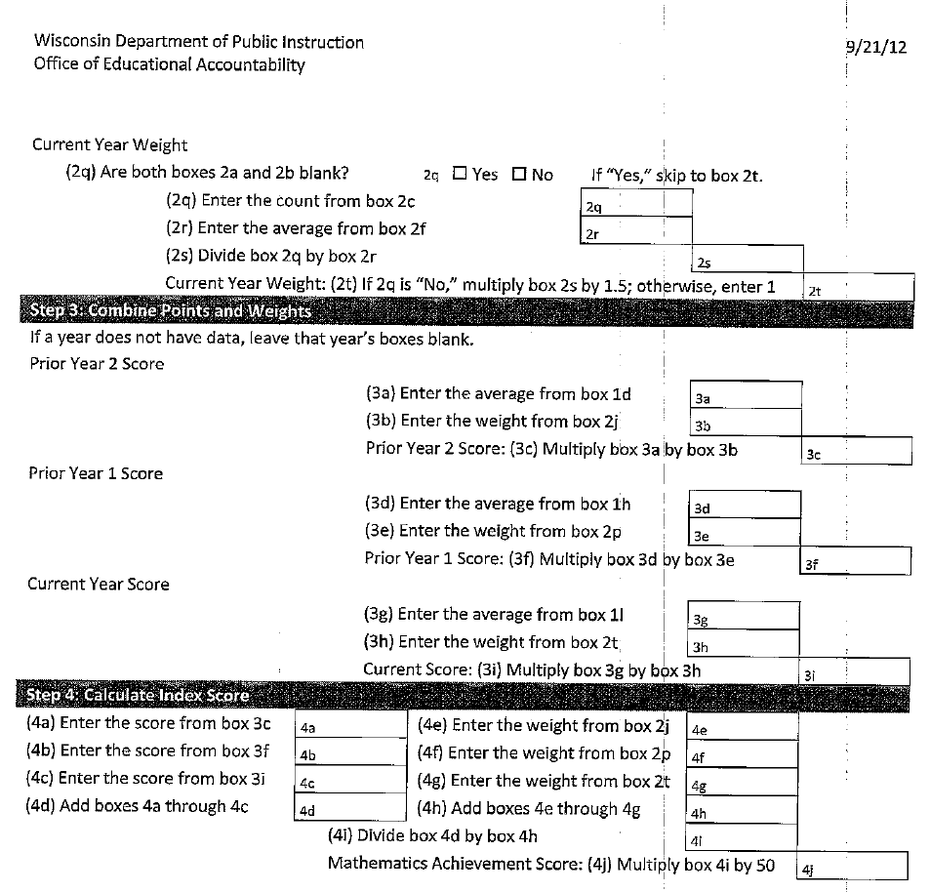
Calculations are complex and complicated

Slide 17
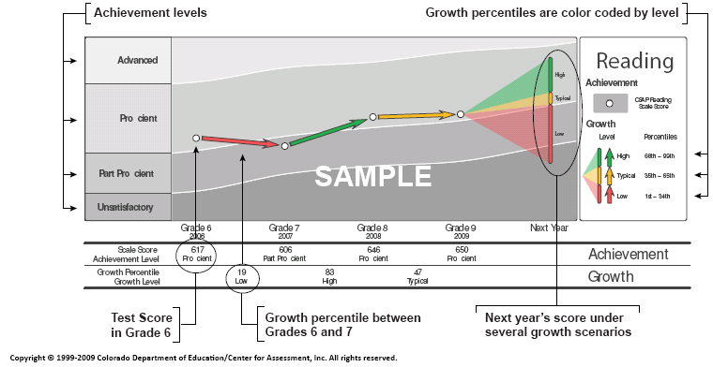
Student Growth Percentile (SGP)
Notes:
SGP – these student growth percentiles were made available to schools last year, showing how individual students are progressing. The new school report does not itself use value-added calculations, but it uses these individual level growth calculations (there has been some debate about this). These student level growth calculations can also be used in a value-added analysis to see how growth varies among groups of students based on the school they’re at, the teacher they have, the program they’re in, etc.

Slide 18
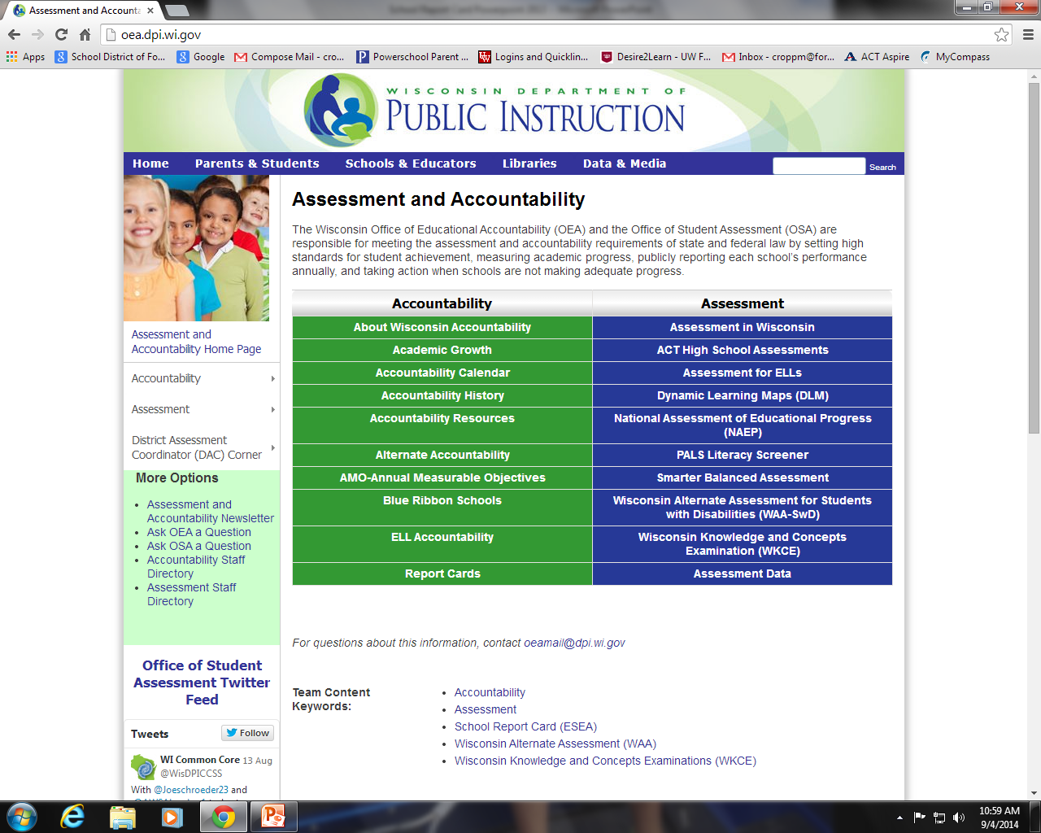
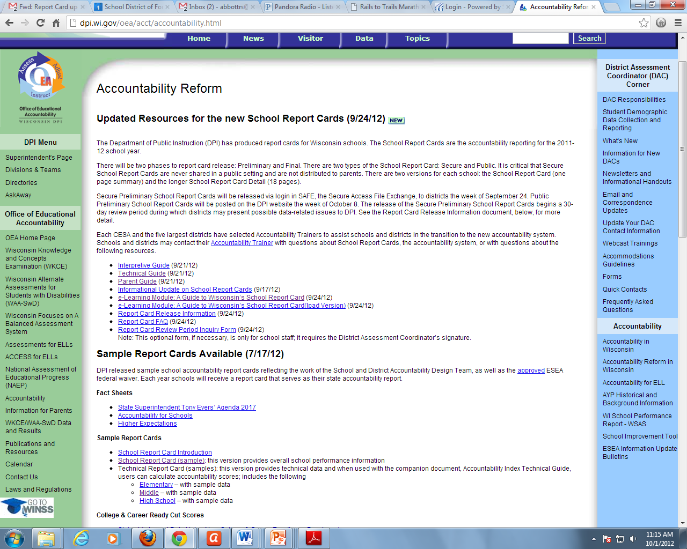
http://dpi.wi.gov/oea/acct/accountability.html
http://oea.dpi.wi.gov/

Slide 19
Fort Atkinson Report Card Results
2014
 | Accountability Score | Accountability Rating
Barrie | 81.0 | Exceeds Expectations
Luther | 75.3 | Exceeds Expectations
Purdy | 77.7 | Exceeds Expectations
Rockwell | 78.2 | Exceeds Expectations
Middle School | 69.0 | Meets Expectations
High School | 77.4 | Exceeds Expectations

Slide 20
Fort Atkinson Report Card Results
Building | Accountability Score |  |  | Accountability Rating
 | 2012 | 2013 | 2014 | 2012 | 2013 | 2014
Barrie | 71.1 | 87.0 | 81.0 | Meets Expectations | Sign.Exceeds Expectations | Exceeds Expectations
Luther | 75.0 | 71.4 | 75.3 | Exceeds Expectations | Meets Expectations | Exceeds Expectations
Purdy | 68.7 | 75.9 | 77.7 | Meets Expectations | Exceeds Expectations | Exceeds Expectations
Rockwell | 75.7 | 73.5 | 78.2 | Exceeds Expectations | Exceeds Expectations | Exceeds Expectations
Middle School | 69.7 | 71.5 | 69.0 | Meets Expectations | Meets Expectations | Meets Expectations
High School | 74.3 | 73.9 | 77.4 | Exceeds Expectations | Exceeds Expectations | Exceeds Expectations

Slide 21
Fort Atkinson Report Card Results district
Year | Accountability Score | Accountability Rating
2014 | 72.5 | Meets Expectations
2013 | 72.5 | Meets Expectations
A score of 73 would place a District in the Exceeds Expectation Category.

Slide 22
Priority Area Scores
STUDENT ACHIEVEMENT
MATH
 | Math (out of 50)
 | 2012 |  | 2013 |  | 2014
 | Local | State | Local | State | Local | State
BARRIE | 40.8 | 37.9 | 43.4 | 37.8 | 45.1 | 38.1
LUTHER | 37.1 | 37.9 | 37.5 | 37.8 | 39.8 | 38.1
PURDY | 39.2 | 37.9 | 39.0 | 37.8 | 39.8 | 38.1
ROCKWELL | 46.0 | 37.9 | 43.4 | 37.8 | 44.0 | 38.1
MIDDLE SCHOOL | 37.1 | 36.1 | 38.0 | 36.7 | 36.9 | 36.8
HIGH SCHOOL | 34.6 | 34.5 | 36.3 | 35.3 | 37.6 | 35.8

Slide 23
Priority Area Scores
STUDENT ACHIEVEMENT
READING
 | Reading (out of 50)
 | 2012 |  | 2013 |  | 2014
 | Local | State | Local | State | Local | State
BARRIE | 29.5 | 28.5 | 33.0 | 28.7 | 33.7 | 28.8
LUTHER | 27.6 | 28.5 | 28.4 | 28.7 | 27.7 | 28.8
PURDY | 27.4 | 28.5 | 27.4 | 28.7 | 30.0 | 28.8
ROCKWELL | 35.4 | 28.5 | 33.3 | 28.7 | 34.4 | 28.8
MIDDLE SCHOOL | 30.8 | 30.3 | 31.4 | 30.7 | 31.3 | 30.5
HIGH SCHOOL | 31.9 | 32.0 | 32.3 | 32.2 | 35.4 | 33.3

Slide 24
Priority Area Scores
STUDENT GROWTH
 | Math (out of 50) |  | Reading (out of 50)
 | LOCAL | STATE | LOCAL | STATE
BARRIE | 33.1 | 33.2 | 29.4 | 34.2
LUTHER | 36.8 | 33.2 | 36.4 | 34.2
PURDY | 28.7 | 33.2 | 34.1 | 34.2
ROCKWELL | 35.2 | 33.2 | 38.4 | 34.2
MIDDLE SCHOOL | 29.5 | 28.1 | 28.9 | 26.9
HIGH SCHOOL | N/A | N/A | N/A | N/A

Slide 25
Priority Area Scores
CLOSING GAPS
 | Math (out of 50 @ K-8) (out of 25 @ HS) |  | Reading (out of 50 @ K-8) (out of 25 @HS) |  | Graduation Rate Gaps (out of 50 – HS only)
 | LOCAL | STATE | LOCAL | STATE | LOCAL | STATE
BARRIE | 31.3 | 35.0 | 30.8 | 34.5 | N/A | N/A
LUTHER | 37.0 | 35.0 | 36.7 | 34.5 | N/A | N/A
PURDY | 29.1 | 35.0 | 30.0 | 34.5 | N/A | N/A
ROCKWELL | 32.5 | 35.0 | 25.0 | 34.5 | N/A | N/A
MIDDLE SCHOOL | 29.2 | 35.4 | 32.8 | 34.2 | N/A | N/A
HIGH SCHOOL | 20.2 | 17.6 | 19.4 | 18.3 | 33.8 | 34.0

Slide 26
Priority Area Scores
On-Track & Post-Secondary Readiness
 | Attendance Rate (out of 80) |  | 3rd Grade Reading Achievement (out of 20)
 | LOCAL | STATE | LOCAL | STATE
BARRIE | 76.8 | 75.4 | 12.6 | 11.3
LUTHER | 77.0 | 75.4 | 11.4 | 11.3
PURDY | 76.2 | 75.4 | 9.9 | 11.3
ROCKWELL | 76.6 | 75.4 | 13.6 | 11.3

Slide 27
Priority Area Scores
On-Track & Post-Secondary Readiness
 | Attendance Rate (out of 80) |  | 8th Grade Reading Achievement (out of 20)
 | LOCAL | STATE | LOCAL | STATE
MIDDLE SCHOOL | 75.2 | 74.9 | 15.2 | 14.0
 | Graduation Rate (out of 80) |  | ACT Participation & Performance (out of 20)
 | LOCAL | STATE | LOCAL | STATE
HIGH SCHOOL | 76.0 | 70.9 | 11.3 | 11.4

Slide 28
Detailed School Report Cards for Each School Available on our Website: www.fortschools.org

Slide 29
Next Steps & Goals …
Continue our planned work with the current strategic plan goals as they directly relate to these measures
Focus on achievement gaps and growth for all students
Continued transition to the Common Core Standards and the increase rigor of expectations
Increased pressure for data accuracy in State reporting
Preparation for all of the new assessments (Smarter Balanced, ACT Aspire, ACT for all students, Dynamic Learning Maps)
Goal of exceeding State average for all areas
All schools and District Exceeding Expectations

